Slide 1
Employee management system
- BY TEAM PSEUDO-MAVERICKS

Slide 2
Project Description
Employee Management Software allows the company to organize their staff and record on an individual level.
There are HR and employee users in the system.
Employees can view their profile, access pay slips, report billing hours, apply leaves and view project hierarchy.
Additionally, HR users can track employees, approve leaves and assign employees to projects.

Slide 3
Development plan for phases
Phase 1:
Login and Registration
Create Database for project
Dashboard of employees and menu
Phase 2:
HR user features for project management and employee management
Leave Management and Timesheet submission
SQL procedures for project
Phase 3:
Build Payroll module
Generate pay slips for employees
System Testing and Integration Testing

Slide 4
Deliverables featured as part of Phase 1
Login screen
Dashboard/Home page
Registration Page

Slide 5
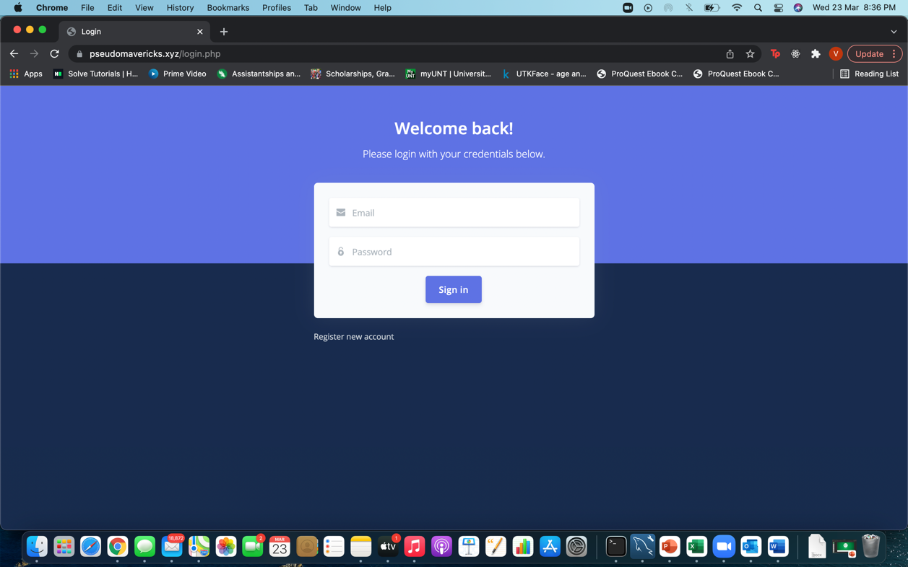
Login Page:
When the user visits the application, it lands on the login page. The user will enter their credentials to login into the application in two fields: username and password. After entering their credentials user will be able to login into the application if the credentials entered are valid or else an error message pops up. It redirects to the dashboard page once logged in.

Slide 6
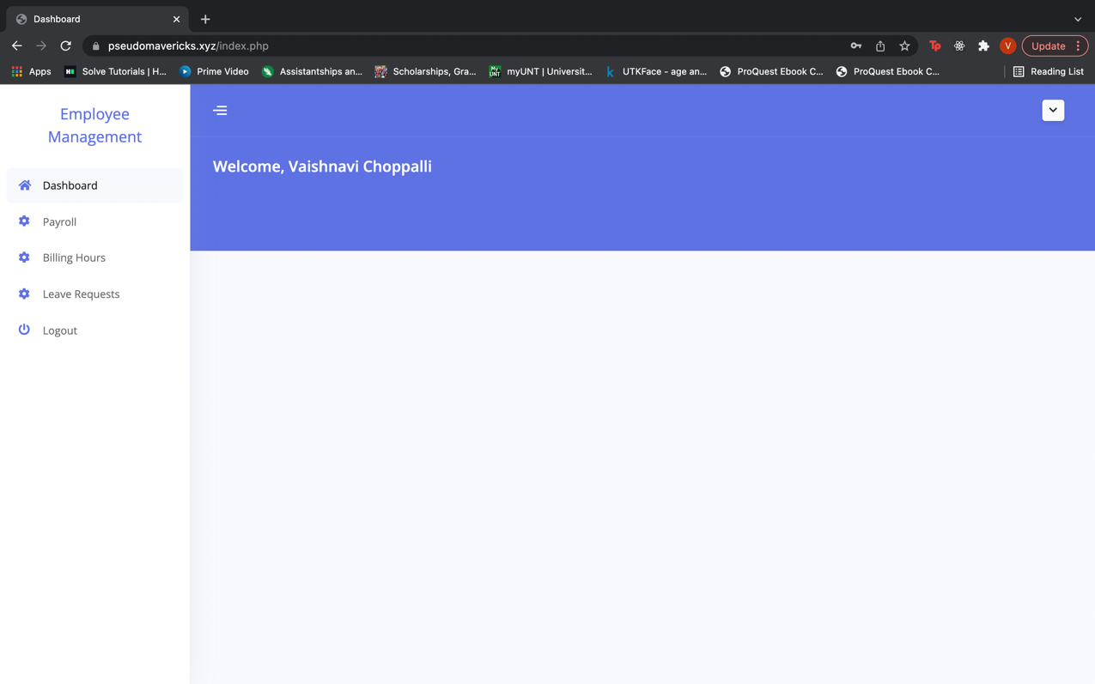
Dashboard/ Home Page:
Once logged into the application the user will be redirected to the dashboard page. It is the home page of the application with the project title “Employee Management System” on the top right. Here the user can find a menu on the right end of the page which contains different menu options like payroll, leave requests, and billing hours. When clicked on any one of the links it redirects to their respective page. It also has a logout button on the top left which enables the user to log out of the application.

Slide 7
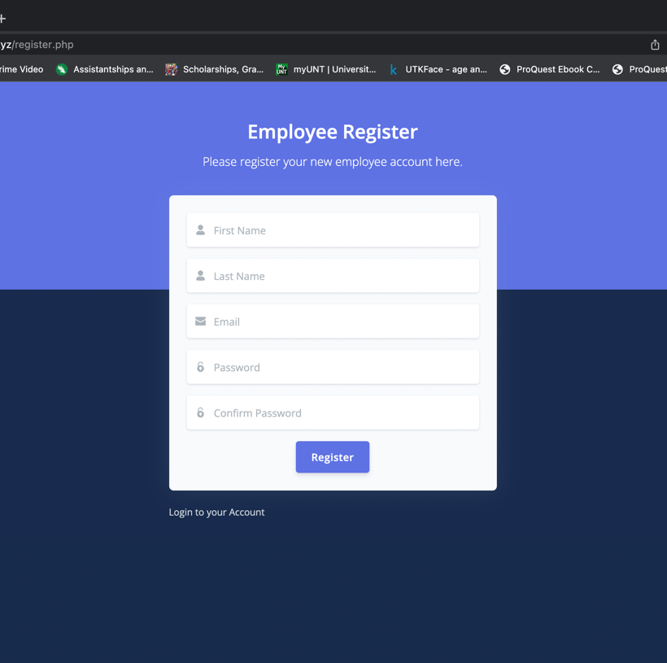
Registration Page:
The registration page is only accessible to the HR and team of the company. They have the privilege to register the employees into the Employee Management System portal. After registering the employees, they will be able to login into the system with their credentials. In the registration page, there are a couple of fields where the details of the employee should be entered such as first name, last name, email Id, and password.

Slide 8
Instructions to run the project
The list of instructions to run the project in their local/computer, the minimum requirements should be:
System specifications
Minimum of intel 5th generation or higher.
RAM: minimum of 4 GB.
Around 5GB of hard disk storage.
To construct the application, the user must first install an IDE (Integrated Development Environment). We prefer Eclipse or NetBeans.
Import the project repository into the IDE and configure the PHP connection.
On the local PC, install the PHP libraries.
Additionally, they must set up a XAMPP server on their PC.
After installation, they need to start the Apache server, MySQL database admin control panels using XAMPP.
After launching, it will navigate the phpMyAdmin console page, where we need to create a database according to the connection file in the project.
After the database has been created, we need to import the SQL file to the database from the appropriate folder location.
Then the user can access the application using their localhost URL.

Slide 9
Clear instructions on how to compile or run both application and test classes.
Download the project zip file.
Can use GitHub to clone the repository using the below URL.
https://github.com/amarendhar-reddy/project-pseudo-mavericks.git
Extract the zip file.
Place the extracted files in XAMPP's htdocs folder.
In the IDE, create a workspace and import the project folder into it.
Configure the PHP to the workspace using the instructions below.
On the toolbar, go to the preferences area beneath the window section.
Select the Installed PHPs under the PHP section.
Add the name and PHP executable file.
Create a database in phpMyAdmin with the name “employee_ms”.
In the database, import the "employee_ms.sql" file.
To start as admin, set up the start page in the IDE's run configurations.
/employee_ms/login.php
Run the application and access the application using the localhost URL.
Ex: http://localhost/employee_ms/login.php#!
To run the test cases, we need to configure the PHPUnit in the IDE.
Navigate to the run configurations, Add the PHPUnit properties.
After adding it, run the application as a PHP unit test.

Slide 10
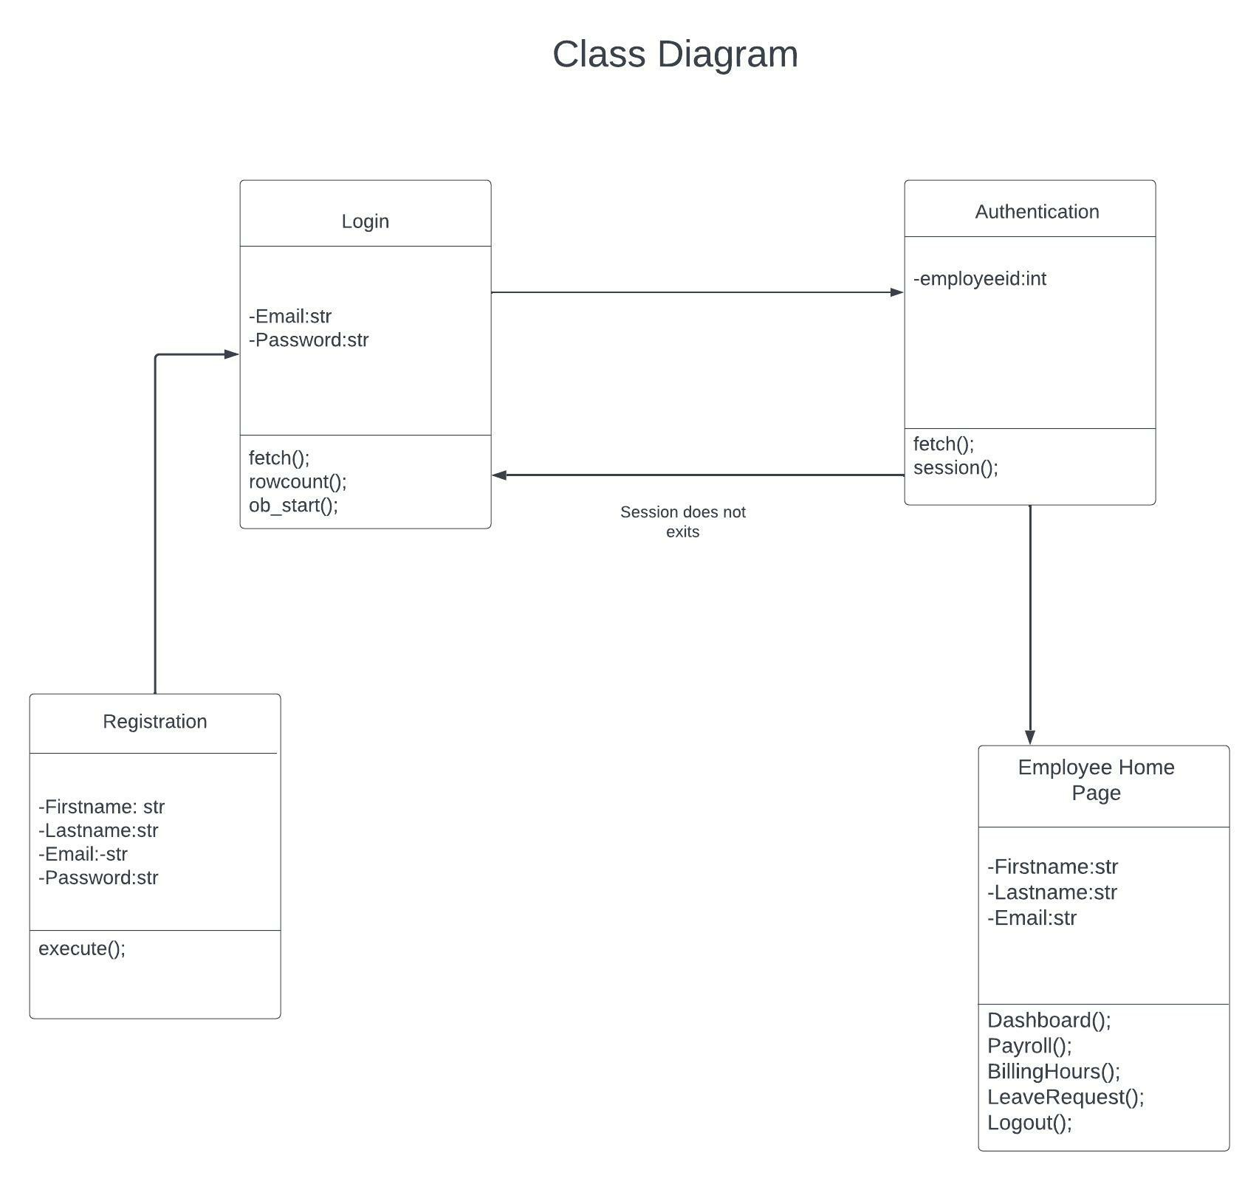
Class Diagram

Slide 11
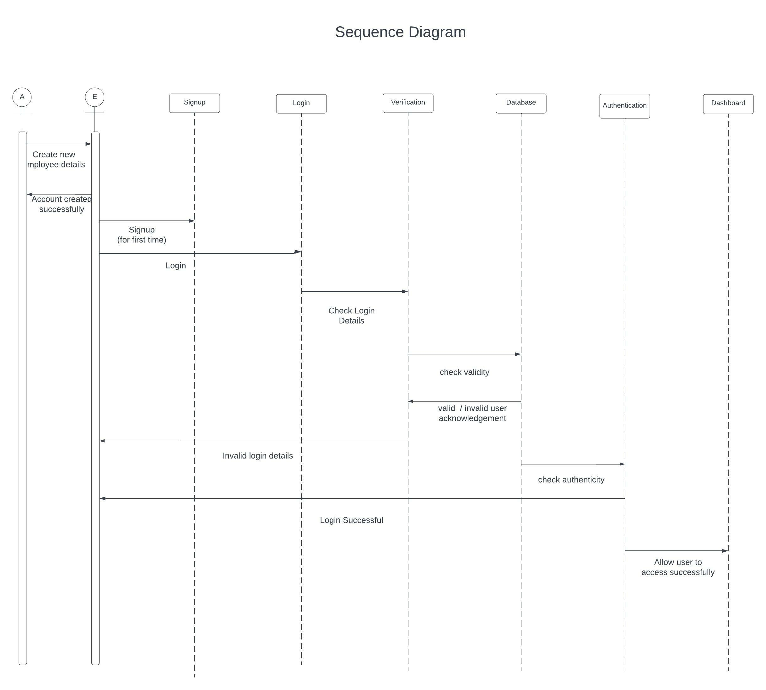
Sequence diagram

Slide 12
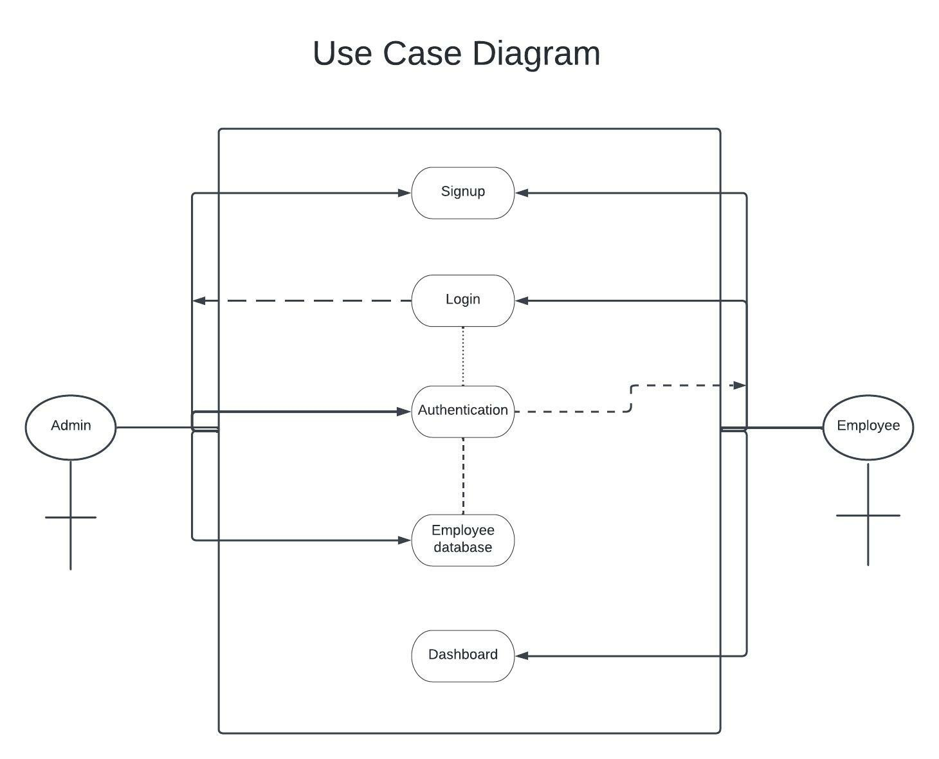
Use case diagram

Slide 13
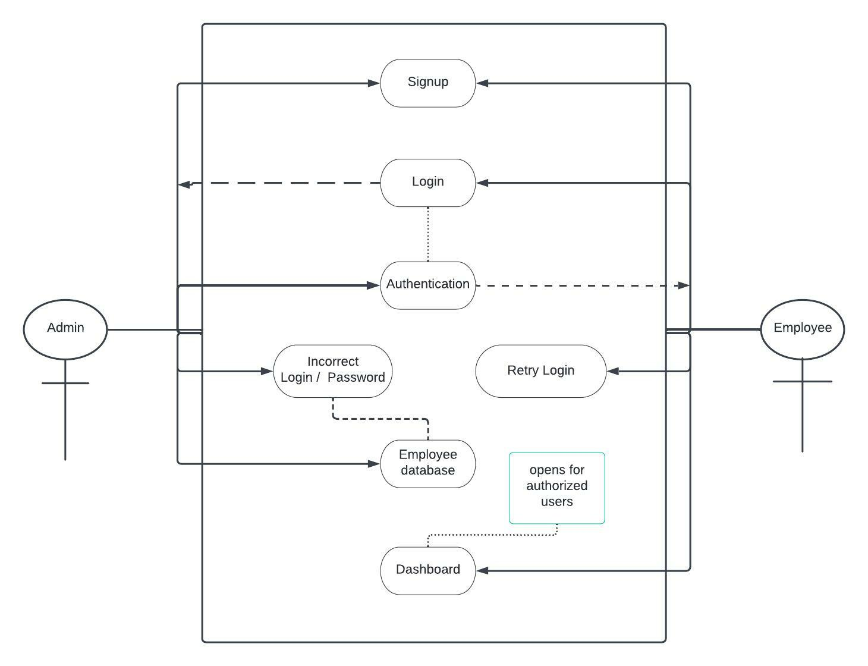
Use case diagram – Error Scenario

Slide 14
THANK YOU

